Slide 1
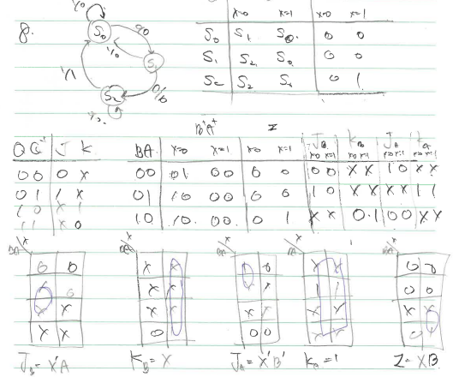
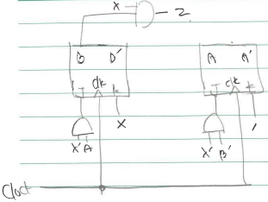
8. Design a Mealy type sequence detector for finding ‘001” with JK type flip-flops. (20 points)

